Slide 1
Feb 7 Update
Circles… more prophetic dreams…. Slay?

Slide 2
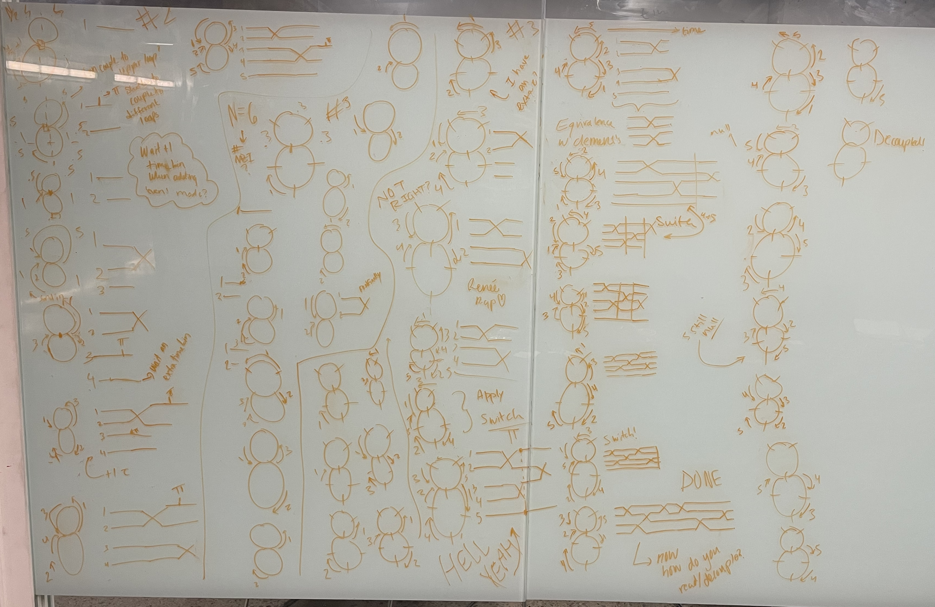
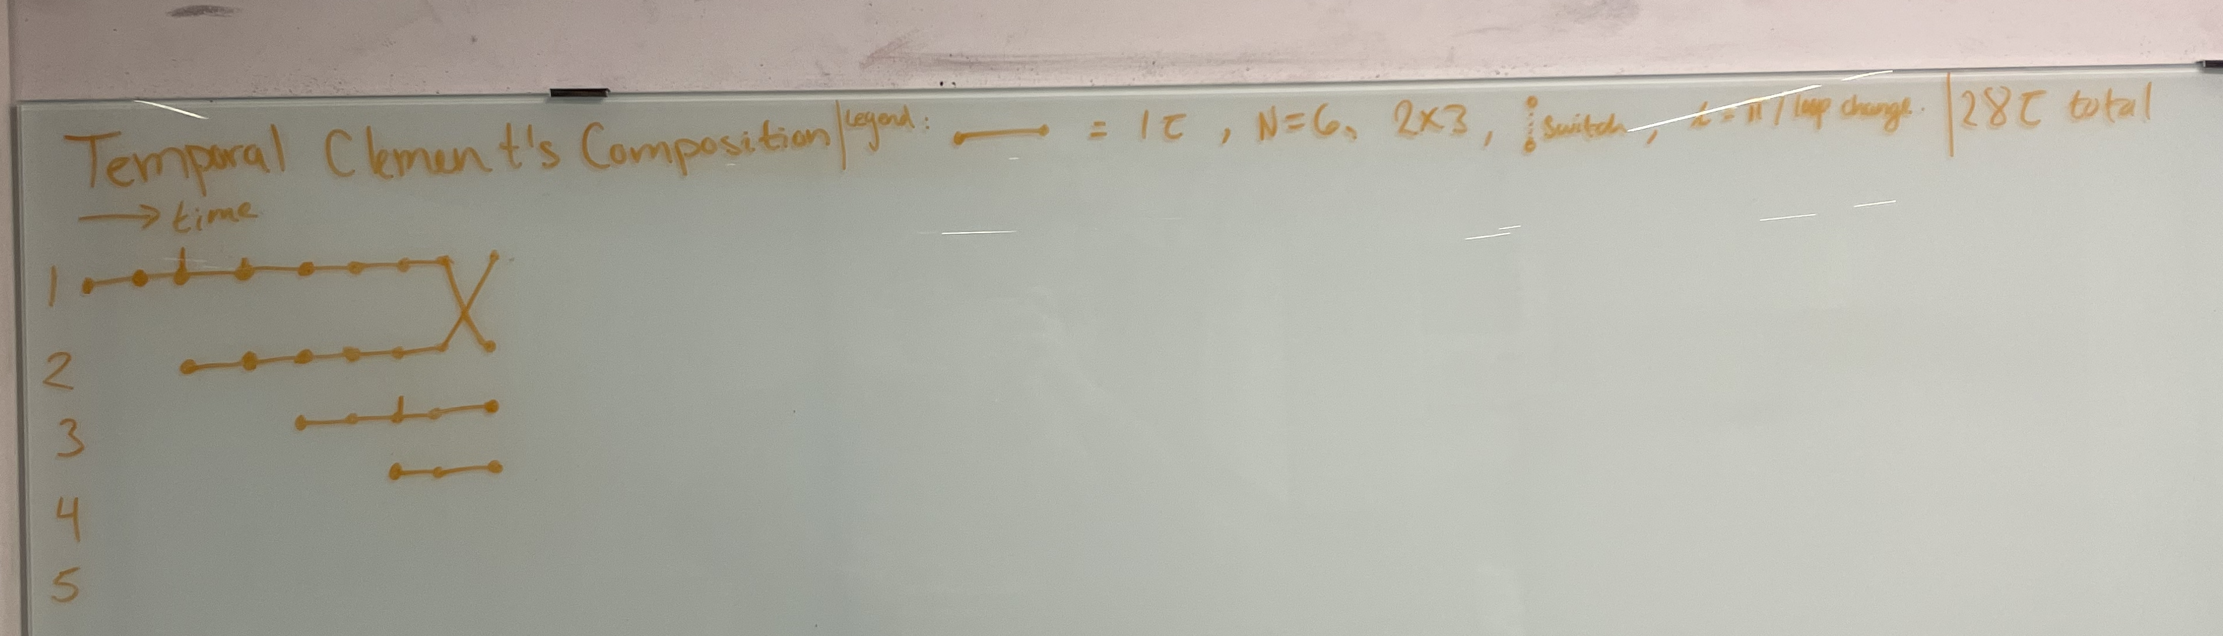
Whats goin on
- I've been drawing circles. So many circles. (for clements)
- tried making a gif for the
reck
- something went wrong
- had another ✨dream✨
- ill write it out
- w h a t is N ? (clements)
- tried doing some literature
Search, ngl didn’t focus on
That a lot…… oops

Slide 3
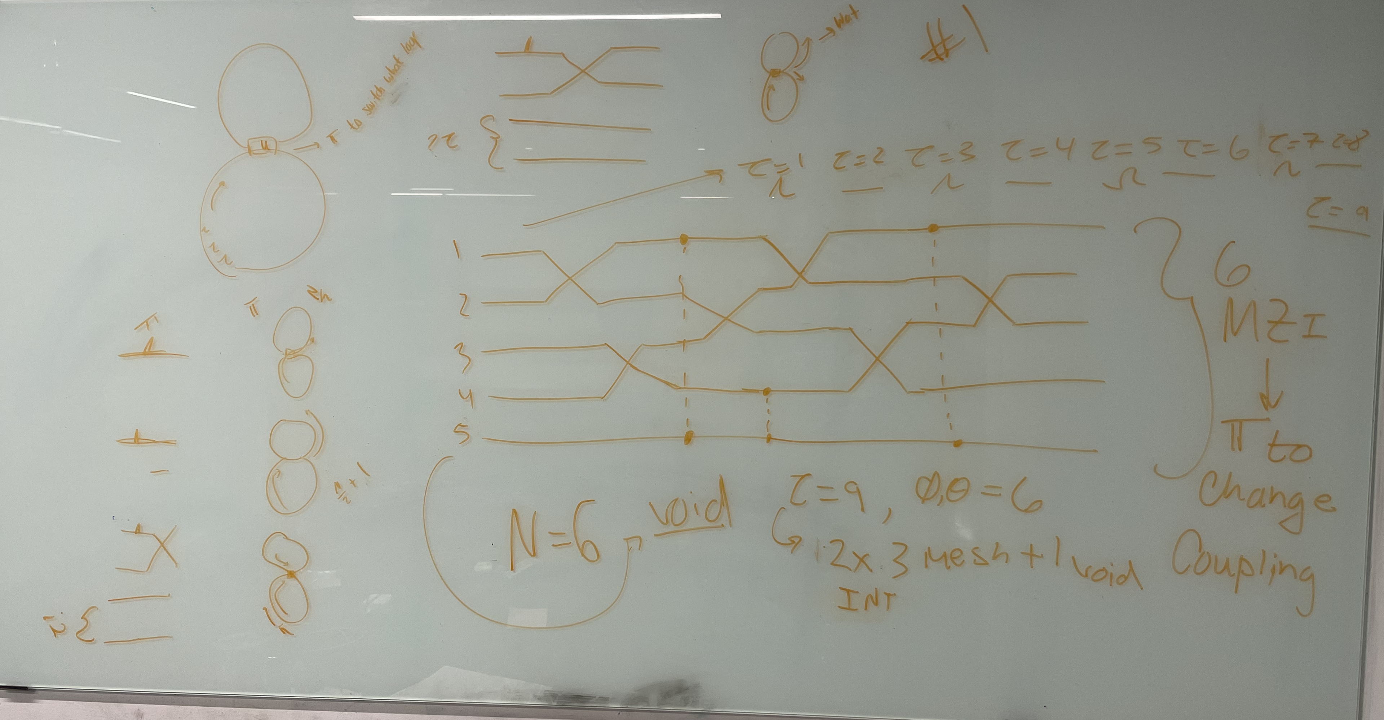

Slide 4
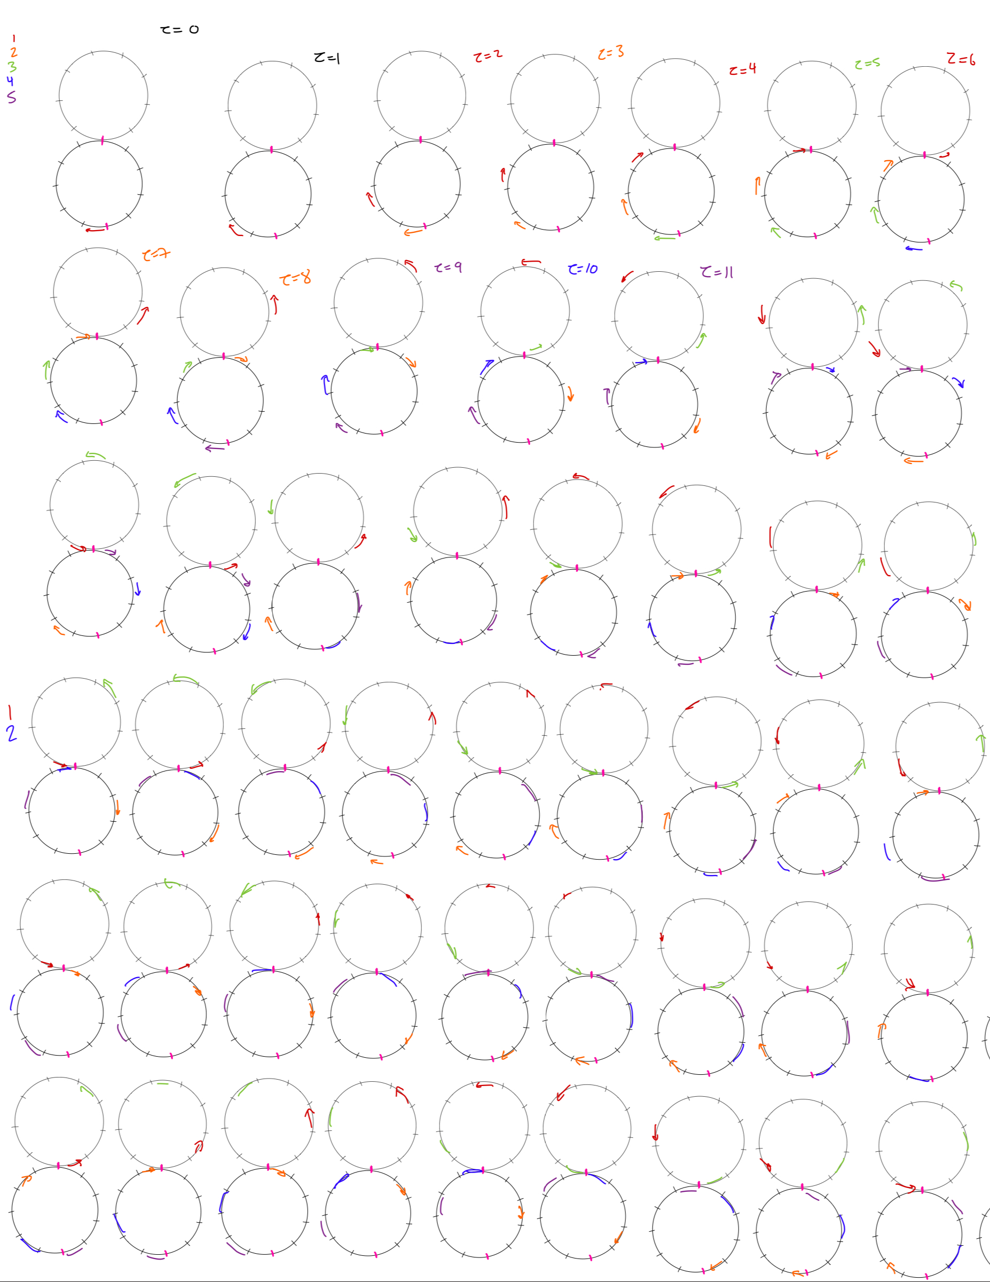
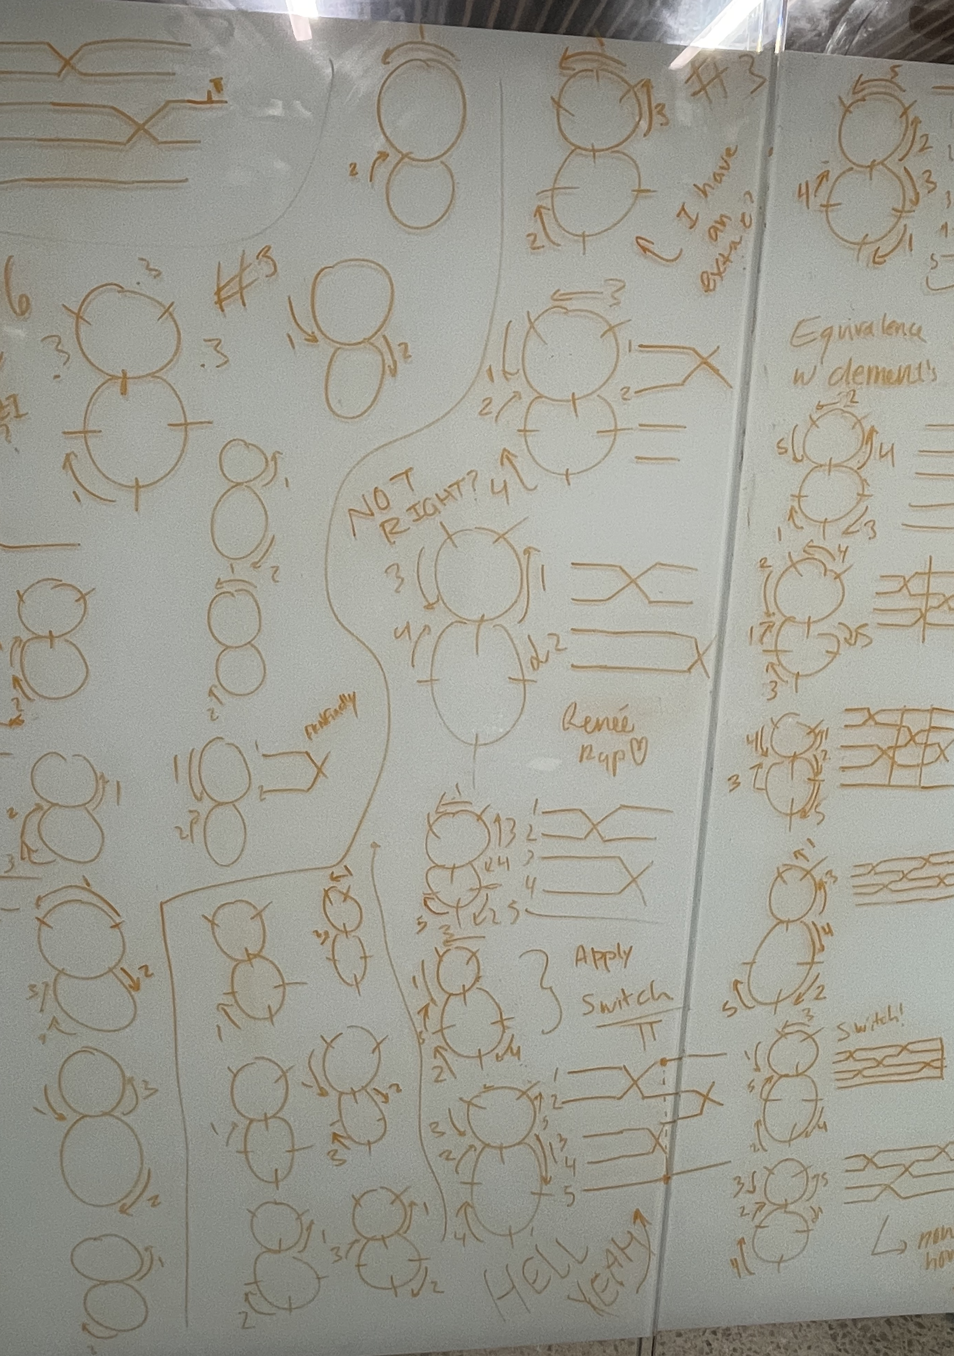
<- absolutely not
Wrong… ->

